Slide 1
Mob Programming
My first team

Slide 2
I am a software engineer with Hunter Industries. This slide deck represents my ideas, and my story.
It in no way represents the views and or opinions of Hunter Industries.

Slide 3


Thank you Hunter
This talk represent my opinions, my story and my thoughts alone.

Slide 4
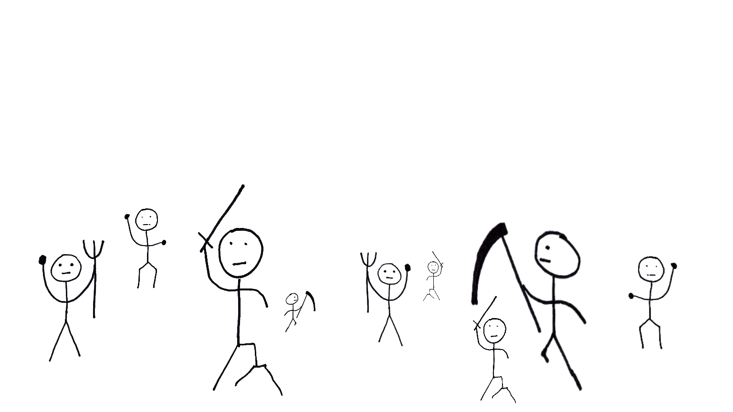
What is Mob-Programming?
@JasonKerney
All the people
working together
working
on the same thing,
on the same computer

Slide 5


Who am I?
R. Jason Kerney
Lover of Code
Newer member
Agilist
Legacy Code Wizard
Mob Programmer
@JasonKerney

Slide 6

Overview
@JasonKerney

Slide 7
How we became a mob
@JasonKerney

Slide 8
Why we are a mob?
@JasonKerney
Because we want to be.

Slide 9

Rules
@JasonKerney
Show Kindness
Show Consideration
Show Respect
… At all Times

Slide 10
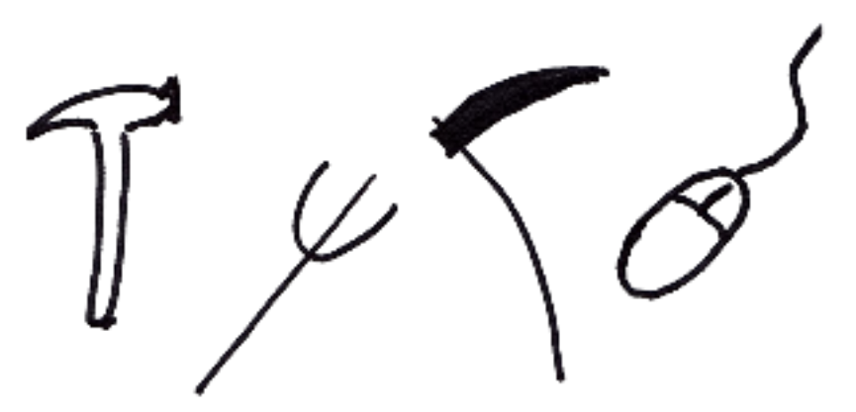
Tools
@JasonKerney
Tools

Slide 11
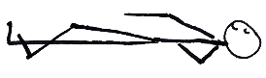
Guidelines
@JasonKerney

Slide 12
Guidelines
@JasonKerney
The Timer

Slide 13
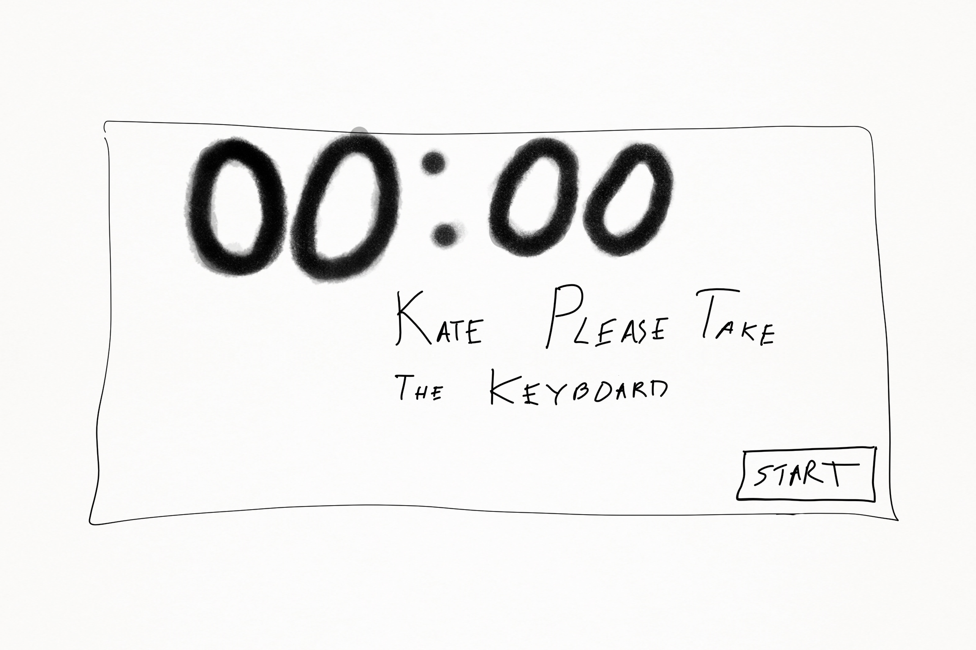
@JasonKerney

Slide 14
Guidelines
@JasonKerney
The Timer

Slide 15
Guidelines
@JasonKerney
The Timer
Driver Navigators

Slide 16
Guidelines
@JasonKerney
The Timer
Driver Navigators
Study Sessions

Slide 17
Guidelines
@JasonKerney
The Timer
Driver Navigators
Study Sessions
Automation

Slide 18
Guidelines
@JasonKerney
The Timer
Driver Navigators
Study Sessions
Automation
Guests / Visitors

Slide 19
Guidelines
@JasonKerney
The Timer
Driver Navigators
Study Sessions
Automation
Guests / Visitors
Retrospect

Slide 20
Guidelines
@JasonKerney
The Timer
Driver Navigators
Study Sessions
Automation
Guests / Visitors
Retrospect

Slide 21
Interviewing
@JasonKerney

Slide 22






Learning as a team
@JasonKerney

Slide 23
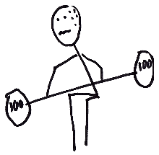
I Struggled
@JasonKerney

Slide 24

Not Advanced Pair Programming
@JasonKerney

Slide 25
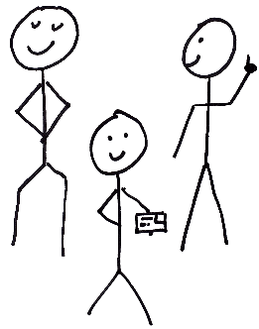
Real Team Work
@JasonKerney

Slide 26
Real Team Work
@JasonKerney
Different Points of View
Support Structures

Slide 27
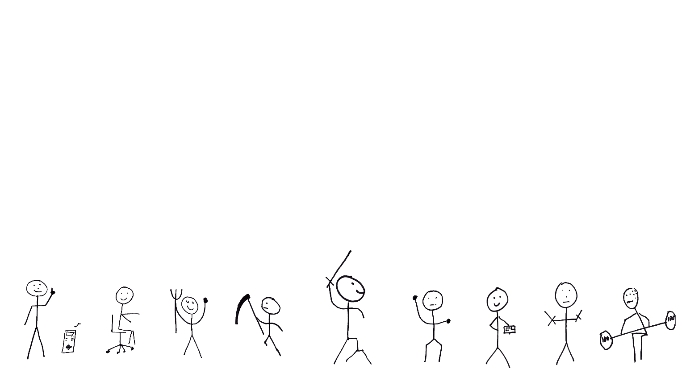
The Perfect Mob…
@JasonKerney

Slide 28
A Personal Note
@JasonKerney

Slide 29
Acknowledgements
@JasonKerney
Woody Zuill
Llewellyn Falco
Woody Zuill

Slide 30
How to Find me
@JasonKerney
@JasonKerney
Jason+Mob@teamkerney.com
bit.ly/rjkBlog
bit.ly/rjkGitHub
bit.ly/rjkIn
The Paper:
bit.ly/rjkFirstTeam

